Slide 1


Home Credit Default Risk Analysis
Jenna Chan
Notes:
Jenna
You will also give an oral presentation in class, presenting your final results to your “clients”.
The presentation should be no more than 10 minutes long. Your goal here is to convince the client that your final chosen model is the one they should use in their loan decisions. This presentation can and should be more technical than Project 1, but still stay focused on the main takeaways that the client needs to know to use your work productively.

Slide 2
Goal & Home Credit Data
Goal: Predict applicants' likelihood of defaulting on a loan using demographic, financial, and social Home Credit data
Home Credit Default Risk dataset
  over 300 features
  demographic & financial information
  applicants’ prior loans & payment histories
  credit card balances
  installment payments
  month cash & debt details
Notes:
Jenna
The Home Credit Default Risk dataset includes over 300 features across multiple data files, each capturing different aspects of loan applicants. The main dataset (application_train.csv and application_test.csv) provides demographic and financial information for each applicant, such as age, income, employment status, family size, and credit history. Additional files offer insights into applicants' prior loans and payment histories (previous_application.csv), credit card balances (credit_card_balance.csv), installment payments (installments_payments.csv), and monthly cash and debt details (POS_CASH_balance.csv and bureau.csv). These files collectively cover social, economic, and behavioral patterns, allowing for a comprehensive analysis of factors influencing credit risk.

Slide 3
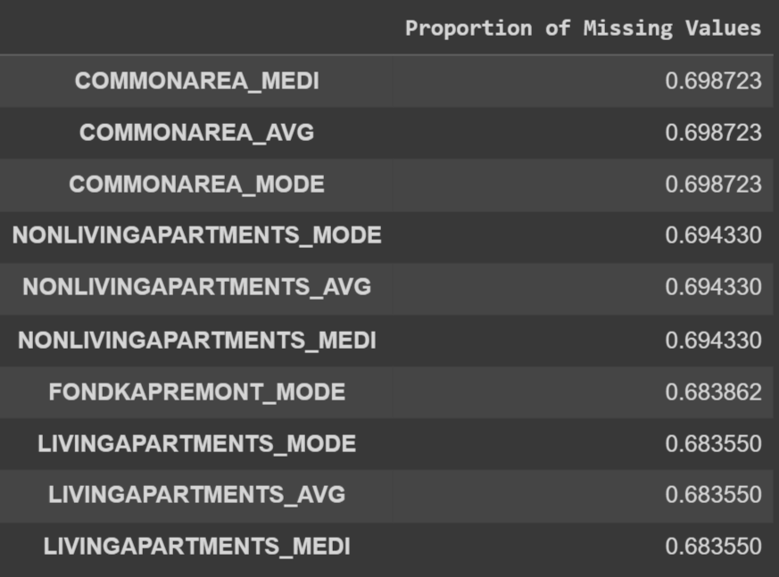
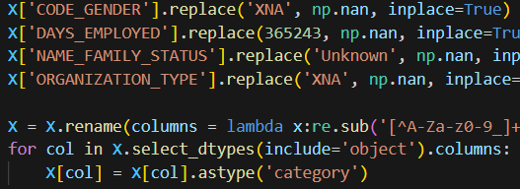
Data Cleaning
For models that required it (Logistic, SVM, LDA): imputed mean for NA’s
Fixed wonky inputs:
For models that required it: standardized
Example of data cleaning done
Lots of missing values
Notes:
Jenna

Slide 4
Feature Select & Engineering
Feature Selection:
Feature importance from Gradient Boosted Tree model
Chose features with importance greater than 0
Feature Engineering:
Aggregated features: sum, min, max, mean, sd when joining the datasets, grouping on ID.
Ratios: Domain knowledge and top 20 most important features
Example of created features
Notes:
Dillon

Slide 5
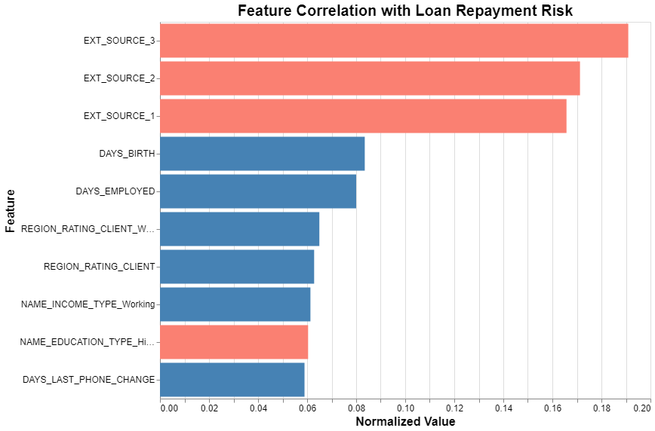
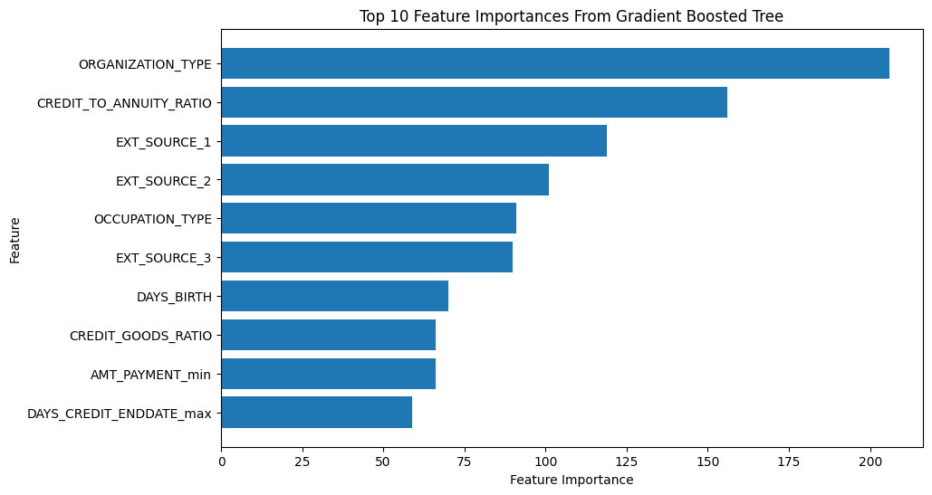
Feature Select & Engineering
Notes:
Dillon

Slide 6
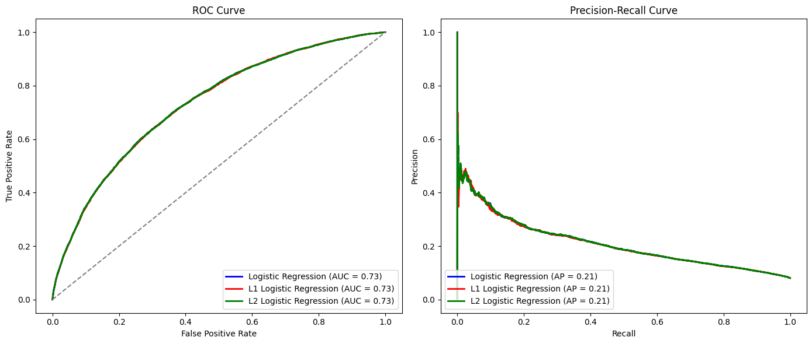
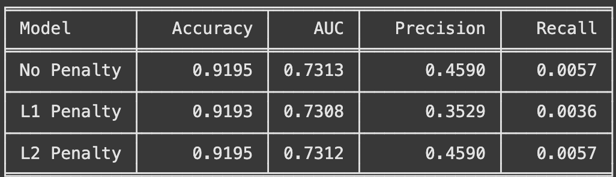
Logistic Regression
Tried no penalty, L1 norm (Lasso), and L2 norm (Ridge)
Highly interpretable, performs well on linearly separable data, works well with regularization
Limited flexibility with non-linear relationships, can underperform on complex data
Notes:
Bernette
We tested Logistic Regression using three variations: no penalty, L1, and L2. All models achieved very similar results across performance metrics. The accuracy of 92%, and the ROC-AUC values around 0.73.
However, the L1 penalty model has a slightly lower precision, not as accurate. L2 shows similar precision to no penalty, so regularization doesn’t affect classification performance. Note: recall is low during preliminary testing, but gets better in our final approach).
While this model performed well on this linearly separable data, logistic regression assumes linearity can be a limitation for more complex, non-linear relations which can be modeled better with flexible models like SVMs or gradient-boosted trees to improve accuracy.
(keep under 1 min)

Slide 7
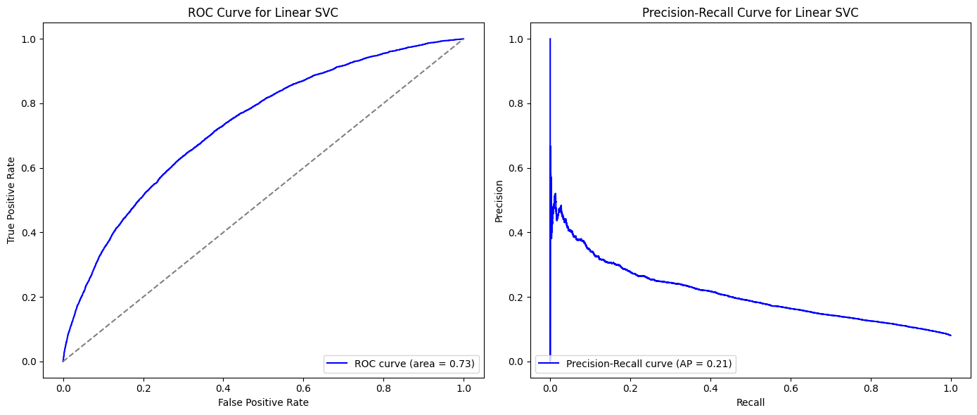
Support Vector Classifier (SVC)
Effective with multiple features (high-dimensional spaces).
Robust against overfitting with proper regularization
Slow training time & sensitive to noise and outliers in data
Notes:
Bernette
The ROC-AUC for Linear SVC is 0.73 and Average Precision of 0.21 from the Precision-Recall curve, both consistent with logistic regression.
Overall, Linear SVC is a reasonable choice for our final model as it works on linearly separable data and high-dimensional spaces, but it has a very slow training time and is sensitive to outliers in the data.
(under 30 sec)

Slide 8
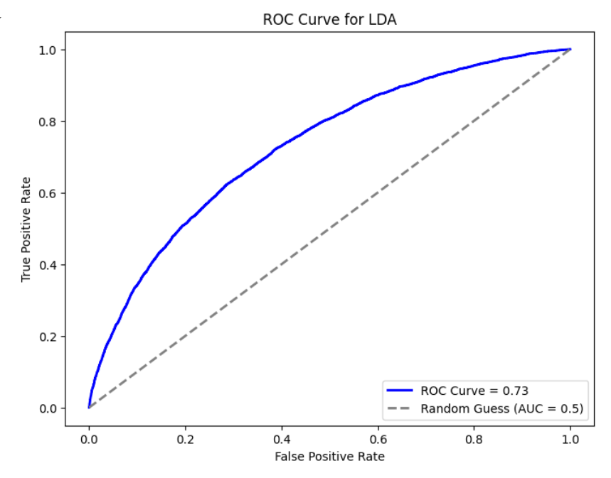
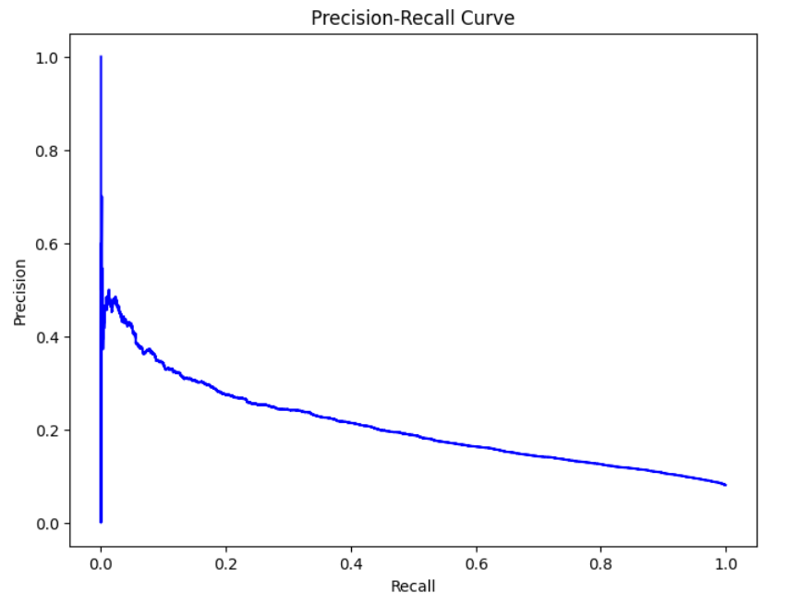
Linear Discriminant Analysis
Quick to train and computationally simple
Reduces feature space while preserving class separability
Prone to performance drops with noise and outliers
Can be biased towards majority classes
Notes:
Jenna

Slide 9
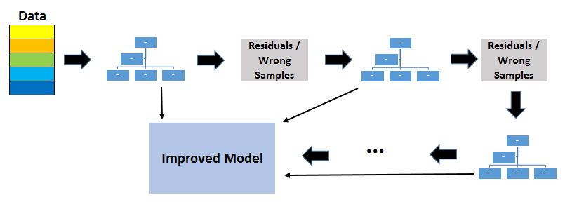
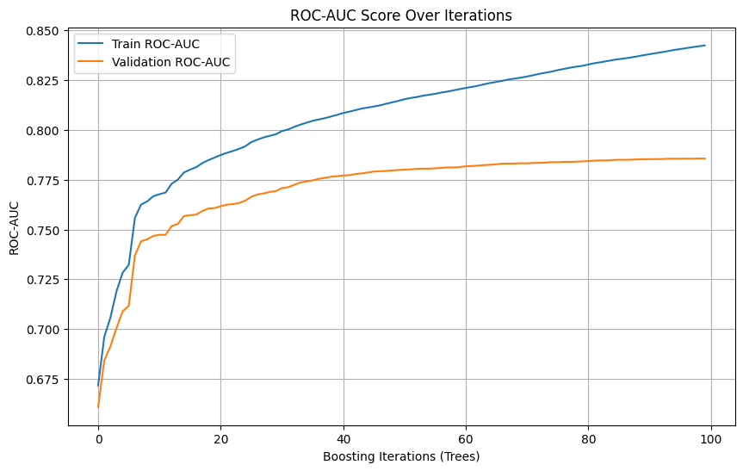
Gradient Boosted Trees (LGB)
LGBM: gradient boosting framework that uses tree based learning algorithms
Works well with large, complex, messy data structures
HyperParameter Tuning:
  Grid searched with 5-fold cv
  "best_params": {"colsample_bytree": 0.27, "min_child_samples": 55, "num_leaves": 53, "reg_lambda": 9}
  Cross-validated ROC AUC: 0.785.
Notes:
Dillon
colsample_bytree (float, optional (default=1.)) – Subsample ratio of columns when constructing each tree.
min_child_samples (int, optional (default=20)) – Minimum number of data needed in a child (leaf).
num_leaves (int, optional (default=31)) – Maximum tree leaves for base learners.
reg_lambda (float, optional (default=0.)) – L2 regularization term on weights.

Slide 10
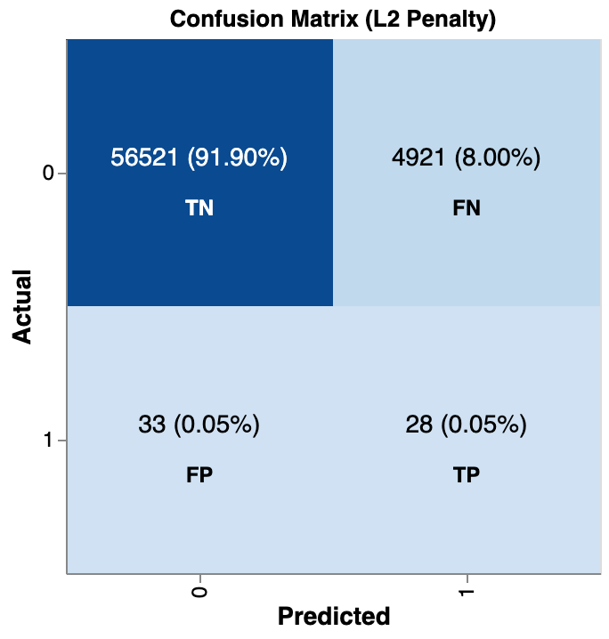
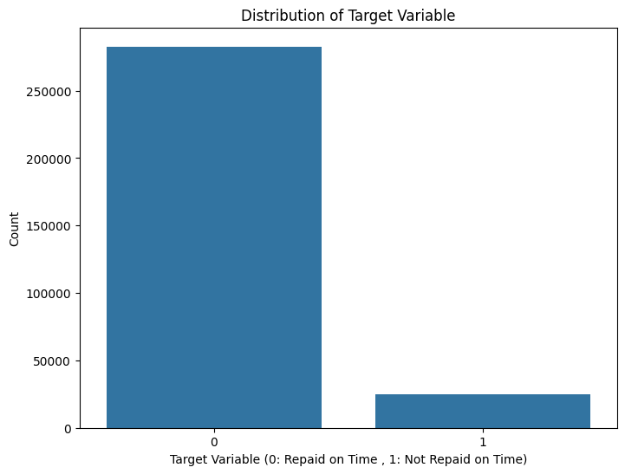
Model Selection Approach
Focus
Minimizing False Negatives
Improving recall while balancing precision
Metrics
Optimizing Metric: F1
Satisficing Metric: ROC-AUC
Satisficing Threshold: 0.7
Model Development Strategy
Stratification across target
Train/Validation/Holdout Test
Hyperparameter Tuning
5-Fold Grid Search
Uneven Class Distribution
Notes:
talk about hyperparameter tuning?
insights & interpretation

Slide 11
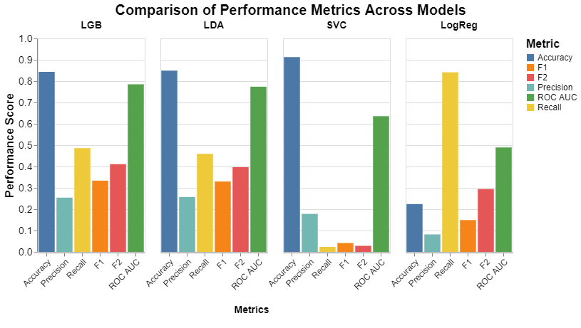
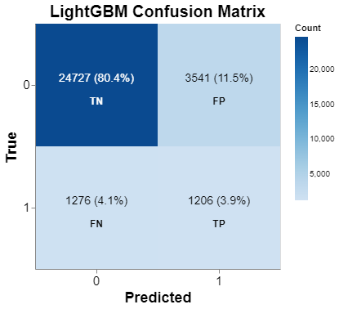


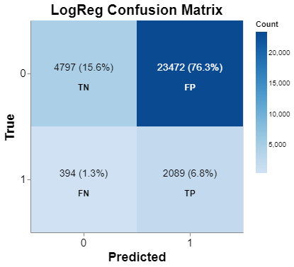
Final Model: LightGBM
Best LGB Hyperparameters
Feature fraction: 0.27
Min leaf data: 55
Max leaves: 53
L2 regularization term: 9
Classification threshold: 0.19
LGB Scoring
Accuracy: 0.8433
Precision: 0.2541
Recall: 0.4859
F1 Score: 0.3337
F2 Score: 0.4109
ROC AUC: 0.7851

Slide 12
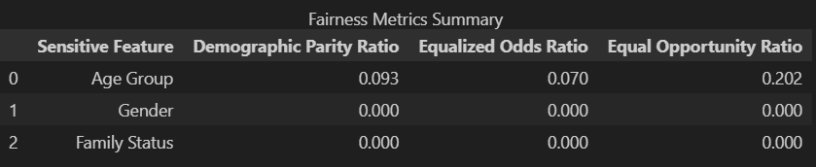
Ethical Considerations
Demographic parity ratio: of 1 means that all groups have the same selection rate.
Equal opportunity ratio: of 1 means that all groups have the same true positive rate.
Equalized odds ratio: of 1 means that all groups have the same true positive, true negative, false positive, and false negative rates.
The model is clearly biased, one or more groups are never receiving a positive prediction and never being predicted correctly. However, removing the protected classes barely harmed our metrics. Resulted in CV roc auc scores of: 0.782
Notes:
Dillon

Slide 13
Conclusion & Next Steps
Class Imbalance: Low F-score due to under-prediction of minority class (defaulters)
Fairness Concerns: Risk of bias remains; protected classes removed from model, but proxy variables may still impact fairness.
High ROC-AUC: Strong overall ranking of applicants' repayment probability
Optimized F-score: Balances false positives and false negatives, supporting risk management in loan decisions.
Takeaways:
Rank loan applicants by repayment probability
Flag high-risk applicants for further review
Optimize loan approval decisions to balance risk
Notes:
Bernette
Our model struggles to correctly predict defaults, which leads to a low F-score.
Even though protected classes (like race or gender) were removed from the model, proxy variables may still introduce bias, so the model could still unintentionally favor/disadvantage certain groups.
With a high ROC-AUC, the model performs well overall in distinguishing the likelihood that someone will repay their loan.
By balancing false positives and false negatives, the model supports better risk management so that loan decisions are made with a balance between missing defaulters and avoiding unnecessary loan denials.
Some actions we recommend are …

